Slide 1
Microsoft Intune Autopilot Deployment & Implementation

Slide 2
Agenda
Team and Roles
Project Evolution/ What I’ve done so far
Windows Autopilot Deployment Process
Windows Autopilot Requirements
Configuration Steps
Security Features
Dynamic Group and Profile Creation
Learning and Challenges
Abandoned and excited features
Toughest bug or interaction

Slide 3

Project Overview
Project Overview
Deploy Microsoft Intune Autopilot
Implement Intune features for device management
Main Goals
Automate provisioning of new devices
Streamline setup and pre-configuration
Key Features
Windows Update Management
Endpoint Analytics
BitLocker Management
Office 365 deployment
Project Phases

Slide 4
Project Success Criteria
Seamless Deployment of Intune Autopilot
Ensures smooth integration and functionality
Timely Completion of All Features
Adherence to project timelines and milestones
High User Satisfaction
Positive feedback from users and IT teams
Avoidance of Security Incidents
Maintaining a secure environment throughout the project
Improvement of Device Management Capabilities
Enhanced control and oversight of organizational devices
Strengthening Security
Creating a Smooth Experience for IT Teams and Users

Slide 5
Solo Project Responsibilities
Multiple Roles and Responsibilities
Act as team leader, project manager, developer, and technical specialist
Deep involvement in all role specialties
Comprehensive Project Management
Planning and research
Hands-on technical implementation and troubleshooting
Self-Reliance and Decision Making
Reading documentation and researching best practices
Resolving technical challenges independently
Ensuring Project Alignment
Managing overall progress
Aligning project with initial goals and objectives

Slide 6
Key Benefits of Windows Autopilot
Traditional IT Admin Tasks
Maintaining various versions of custom Windows images
Managing drivers for every device model
Windows Autopilot Advantages
Uses OEM-optimized Windows 10/11
Leverages existing Windows installation
Makes devices ‘business-ready’ without reimaging
Autopilot Deployment Process
Purchase: Customer/Organization buys the laptop
Shipment: Device vendor, OEM, or reseller ships the laptop
Delivery: Laptop is delivered to the end user
Resetting the Laptop

Slide 7
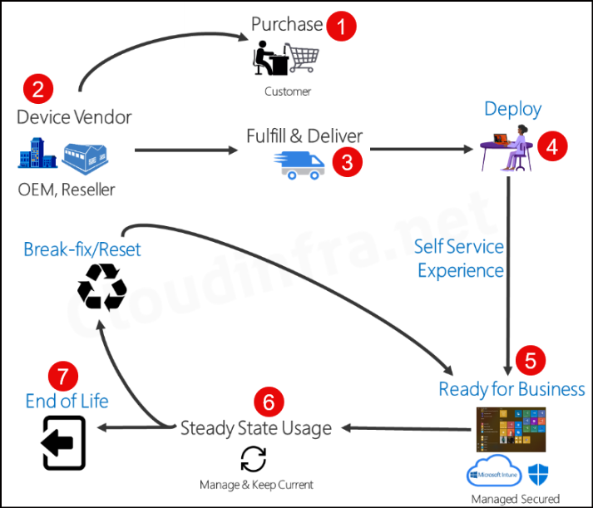
Windows Autopilot Overview
The sketch on the right illustrates the starting point of the Windows Autopilot deployment process and serves as a visual aid to help you better understand how Autopilot works.

Slide 8
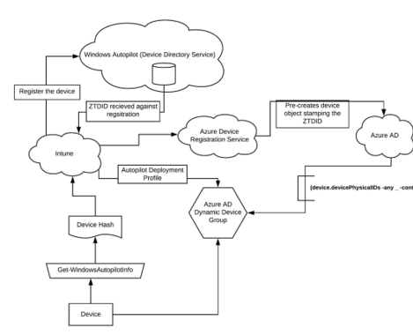
High-level Architecture
Windows Autopilot Design Overview
This reference architecture shows how we will implement Autopilot to integrate with Microsoft Intune in Azure environment with Microsoft Entra ID

Slide 9

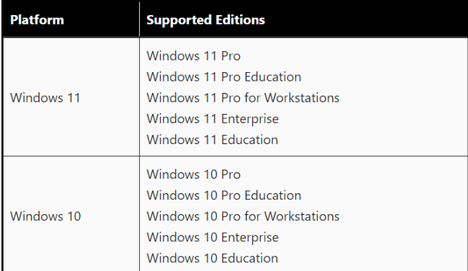
Supported Versions/Licensing
Required Subscriptions for Windows Autopilot
Microsoft 365 Business Premium
Microsoft 365 F1 or F3
Microsoft 365 Academic A1, A3, or A5
Microsoft 365 Enterprise E3 or E5
Enterprise Mobility + Security E3 or E5
Intune for Education
Microsoft Entra ID P1 or P2 and Microsoft Intune

Slide 10

List of Key tasks completed
Setting Up the Environment
Prepare infrastructure for Autopilot
Deploying and Configuring Devices
Ensure devices are properly deployed
Configure devices according to requirements
Implementing Essential Intune Features
Integrate necessary Intune features
Testing the Configurations
Verify all configurations are working correctly
Creating Use Cases
Develop use cases to support implementation

Slide 11
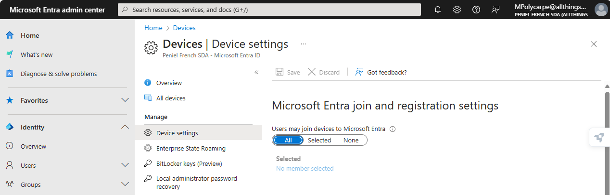
Allow Users to Join Devices to Entra ID
Importance of Joining Devices to Entra ID
Critical for device enrollment in Intune
Ensures proper device management
Options for Allowing Users
Select All: All users can join devices
Selected: Use existing Entra security groups

Slide 12
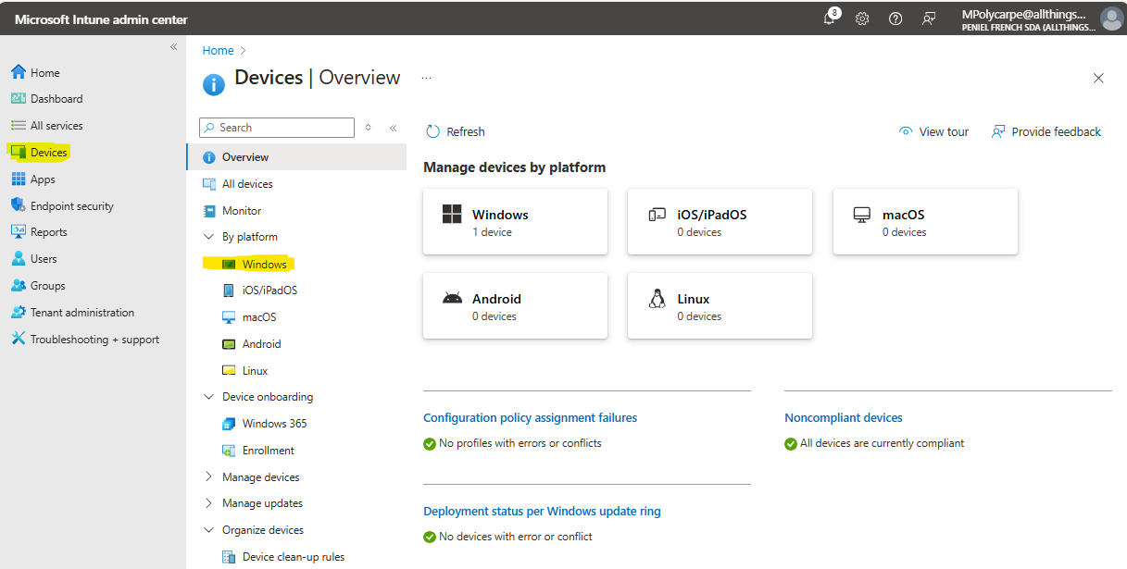
Enable Automatic Enrollment
Device Enrollment Process
Device joins Entra ID
Automatic Enrollment enabled
Device enrolls in Intune
Configuration Steps
Set MDM user scope to All
Set Windows Information Protection (WIP) user scope to None
Project Success Criteria
Seamless deployment of Intune Autopilot
Timely completion of all features
High user satisfaction

Slide 13
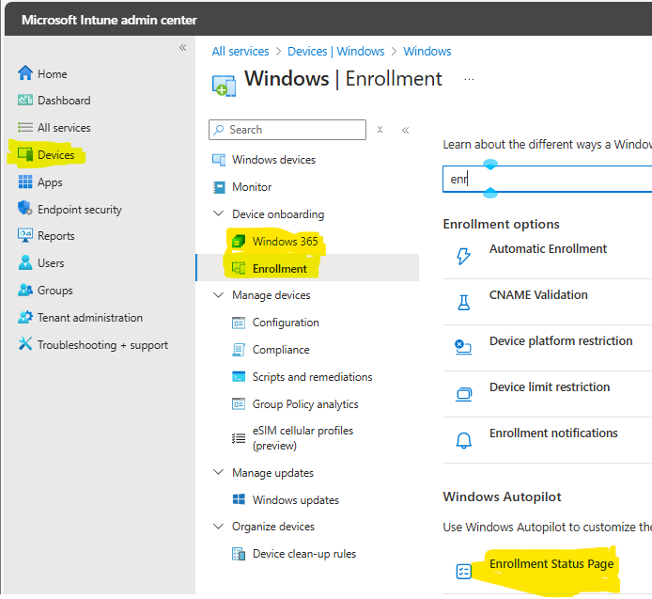
Setup Enrollment Status Page (ESP)
Enrollment Status Page (ESP) Overview
Appears during initial device setup and first user sign-in
Shows configuration progress of assigned apps and profiles
ESP Configuration in Microsoft Intune Admin Center
Manages end-user experience during device provisioning
Highlights two ESP profiles: Windows Autopilot and All Users and All Devices
ESP Functionality in Windows Autopilot
Ensures devices are fully configured and compliant before user access
Monitors app installation, profile configuration, and policy assignments
Provides real-time updates throughout the setup process
Benefits of ESP
Streamlines deployment

Slide 14
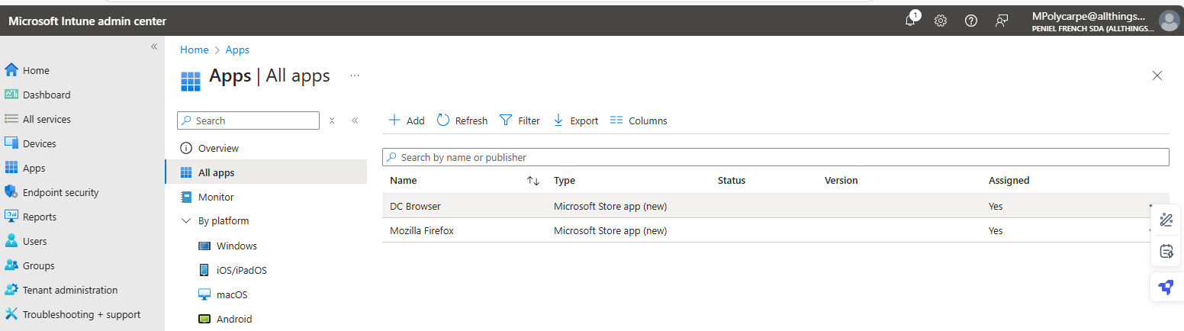
Add and Assign an App to Intune
Using Intune for App Management
Intune helps add and assign apps to the workforce.
Ensures end users have necessary apps for their tasks.
Admin's Role in App Assignment
Admins prioritize providing access to essential apps.
Facilitates smooth workflow for end users

Slide 15
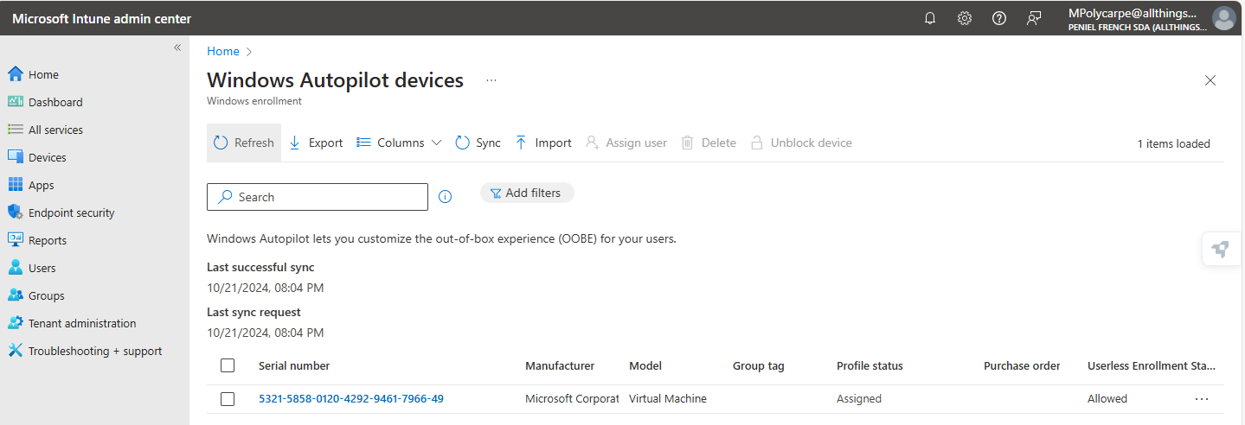
Register and Assign Devices

Slide 16
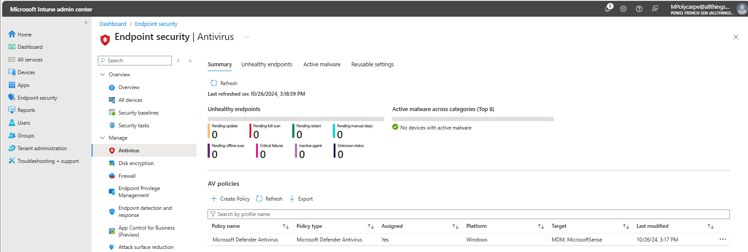
Microsoft Defender Antivirus (MDAV)
Antivirus Health Overview
All metrics for unhealthy endpoints are at zero
No devices with active malware
Environment is secure
Policy Details
Policy: Microsoft Defender Antivirus
Assigned via MDM and Microsoft Sense
Latest modification on 10/26/24
Key Features of MDAV
Cloud Protection: Enabled for new threat detection
High & Severe Threats: Automatically quarantined
Email Scanning: Active to block malicious attachments

Slide 17
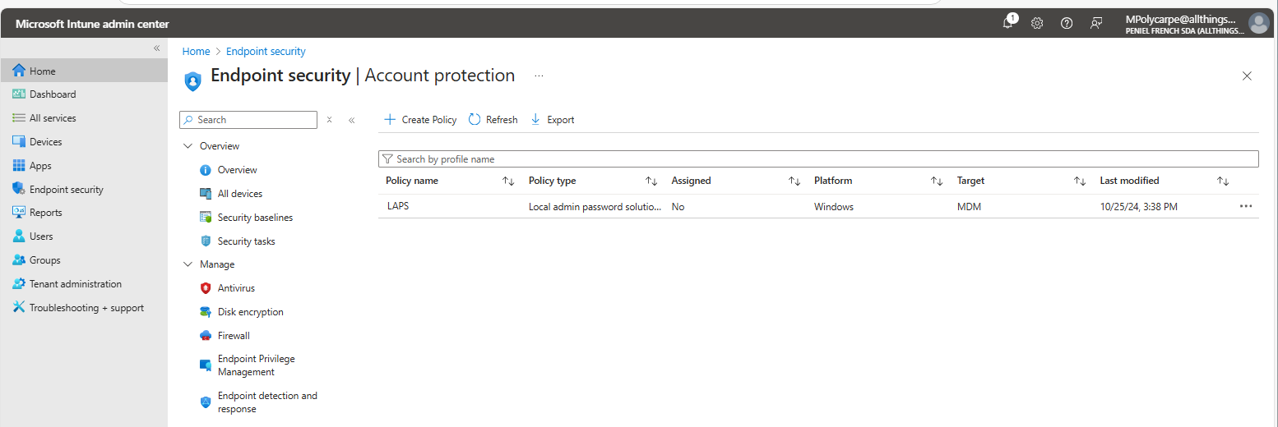
Windows Local Administrator Password Solution (LAPS)
Purpose of LAPS
Securely manage and store passwords for local administrator accounts
Default Settings
Built-in local administrator account is disabled by default
Use Cases
Useful for troubleshooting, support, or device recovery
Integration with Microsoft Entra
Randomizes and stores passwords securely
Works with Intune as MDM service
Account Creation and Enabling
LAPS does not create or enable local accounts
Accounts must be created/enabled separately using scripts or CSPs

Slide 18
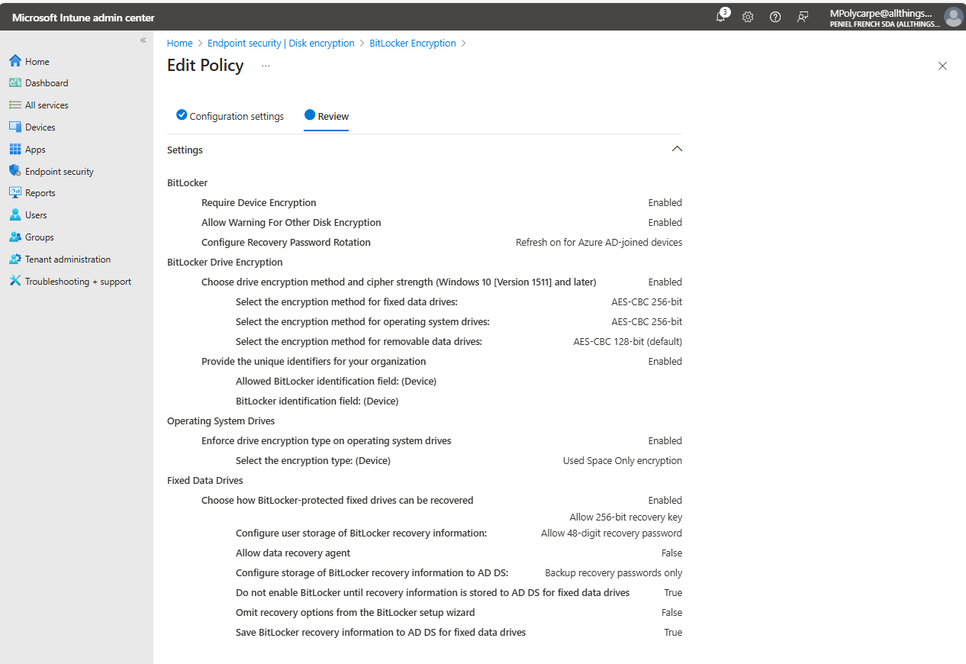
BitLocker Encryption
BitLocker Encryption Overview
Full-disk encryption feature in Windows
Secures data by encrypting the entire drive
Prevents unauthorized access if a device is lost or stolen
Policy Configuration in Intune
Settings include encryption methods, password rotation, and recovery options
Enforces AES-CBC 256-bit for fixed and OS drives
Uses AES-CBC 128-bit for removable drives
Requires BitLocker recovery keys to be backed up to Active Directory (AD)
Encryption Types
AES-CBC 256-bit: Stronger security, preferred for high-security needs
AES-CBC 128-bit: Faster performance, suitable for less critical data

Slide 19
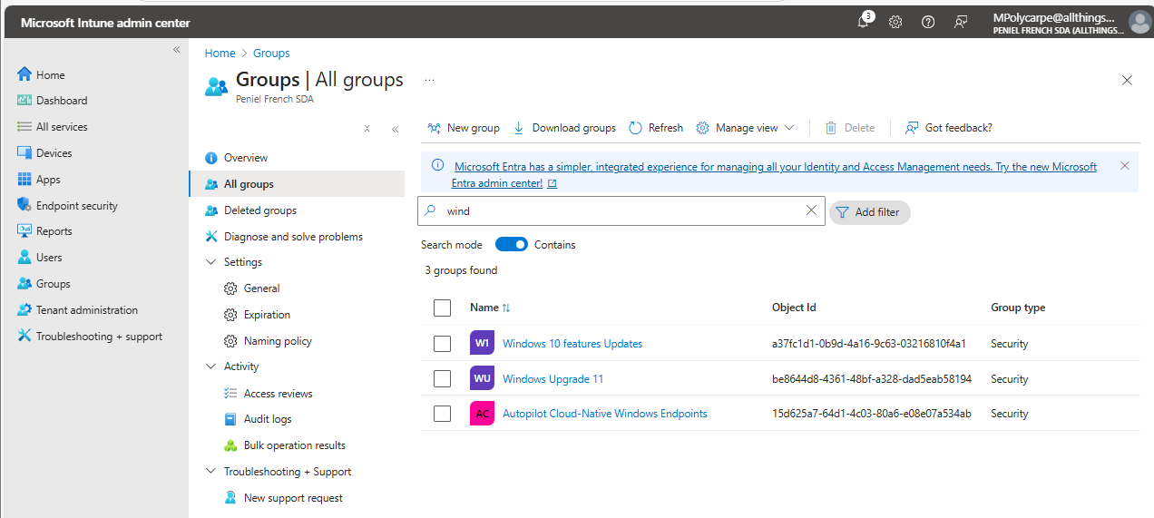
Create Microsoft Entra Dynamic Group
Created a Dynamic Microsoft Entra Group
Automatically includes devices imported to Windows Autopilot
Used Group Tag Cloud Native
Target Configurations and Applications
Apply settings to the dynamic group
Note on Dynamic Groups
Groups take a few minutes to populate
Longer wait times in large organizations
Confirm device membership after a few minutes

Slide 20
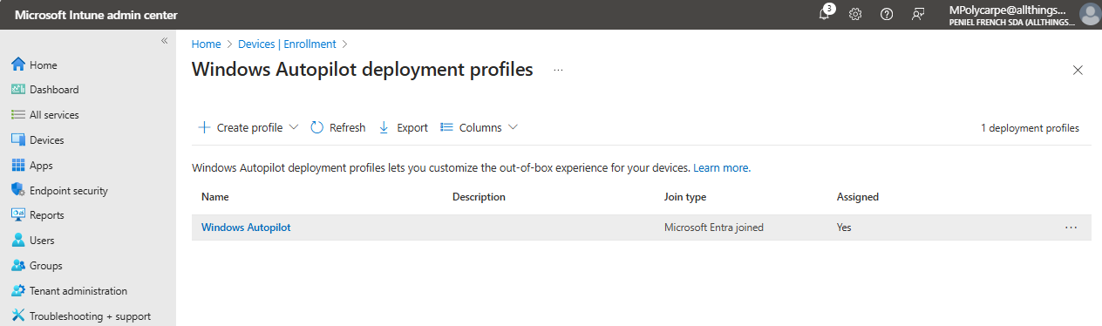
Created and Assigned the Windows Autopilot Profile
Purpose of Windows Autopilot Profile
Automates the setup of new Windows devices
Reduces manual configuration
Specifies key settings like policies, apps, and configurations
Configuration in Microsoft Intune
Manages how Windows devices are set up during OOBE
Defines how devices join Microsoft Entra ID
Applies settings or policies automatically
Assignment to Microsoft Entra Group
Assigned to a test group called "Autopilot Cloud-Native Windows Endpoint"
Devices in this group automatically apply profile settings during OOBE
Ensures devices are business-ready with minimal user intervention

Slide 21
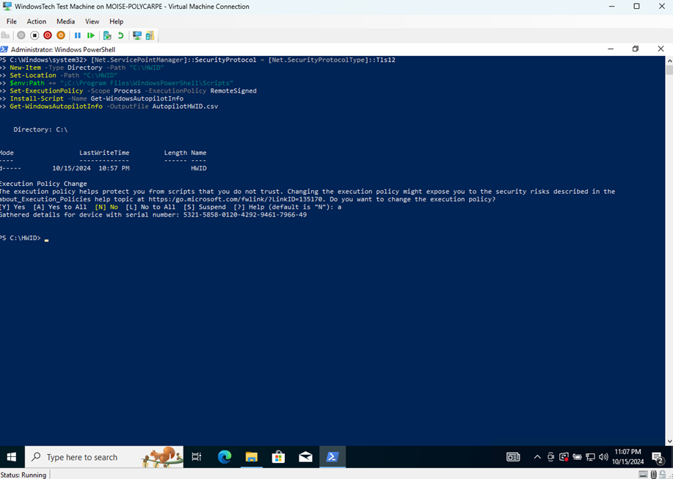
Hours Spent Learning
Time Investment in Learning
Substantial hours dedicated to understanding new technologies and techniques
Focus on virtualization and device deployment using Windows Autopilot
Documentation and Troubleshooting
Extensive reading of Microsoft documentations
Understanding environmental setup and troubleshooting configurations
Toughest Bug or Interaction
Ran into some issues producing the hash ID to enroll the VMs. After longs hours of troubleshooting, I realize it was related to permission and a minor error in my code.

Slide 22
Abandoned and Exciting Features
Technical Challenges Encountered
Abandoned rolling out Windows 11 Integration
Compatibility issues with Windows 11
Technical challenges with Windows Autopilot
Errors in virtual machine setup
Exciting Features
Configured BitLocker to encrypt all devices
Deployed Defender for all endpoints
These enhancements remind me that as we develop solutions to address real-world challenges, prioritizing security is essential.

Slide 23
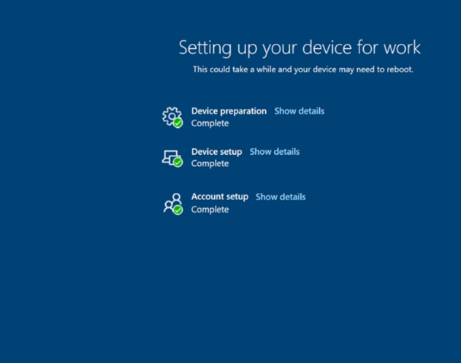
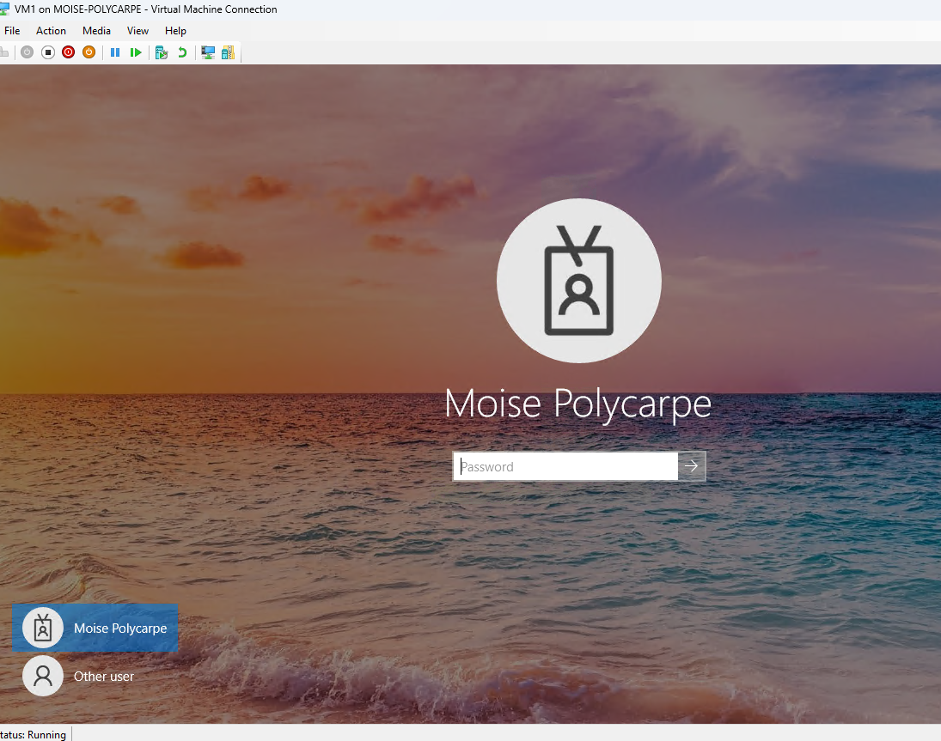
Mockup of the final look
On the left is a mockup of what a new hire would encounter when accessing company hardware for the first time. Users will need to follow these straightforward steps before they can log in.

Slide 24
https://github.com/error404progtech/Intune-Autopilot.git
https://trello.com/invite/b/66ee40796cad08da9f66d3be/ATTI0d4e2e32b3efdb83d8d9b13e9245336f54DD8877/autopilot-intune-deployment

